Slide 1

William Stallings, Computer Organization and Architecture, 9th Edition
Instruction Sets:
Characteristics and Functions
Chapter 12
Notes:
Lecture slides prepared for “Computer Organization and Architecture”, 9/e, by William Stallings, Chapter 12 “Instruction Sets: Characteristics and Functions”.
Adapted by Thân Văn Sử
Much of what is discussed in this book is not readily apparent to the user or programmer of a computer. If a programmer is using a high-level language, such as Pascal or Ada, very little of the architecture of the underlying machine is visible.
One boundary where the computer designer and the computer programmer can view the same machine is the machine instruction set. From the designer’s point of view, the machine instruction set provides the functional requirements for the processor: implementing the processor is a task that in large part involves implementing the machine instruction set. The user who chooses to program in machine language (actually, in assembly language; see Appendix B) becomes aware of the register and memory structure, the types of data directly supported by the machine, and the functioning of the ALU.
A description of a computer’s machine instruction set goes a long way toward explaining the computer’s processor. Accordingly, we focus on machine instructions in this chapter and the next.

Slide 2

Objectives
Questions:
What is the structure of a machine instruction?
What can computers do?
After studying this chapter, you should be able to:
Present an overview of essential characteristics of machine instructions.
Describe the types of operands used in typical machine instruction sets.
Notes:
2

Slide 3
Contents
12.1 Machine Instruction Characteristics
12.2 Types of Operands
12.4 Types of Operations
Notes:
2

Slide 4
12.1- Machine Instruction Characteristics
The operation of the processor is determined by the instructions it executes, referred to as machine instructions or computer instructions
The collection of different instructions that the processor can execute is referred to as the processor’s instruction set
Each instruction must contain the information required by the processor for execution
Instruction’s semantic is works which are performed by hardware.
Notes:
2
The operation of the processor is determined by the instructions it executes, referred to as machine instructions or computer instructions. The collection of different instructions that the processor can execute is referred to as the processor’s instruction set.
Each instruction must contain the information required by the processor for execution.

Slide 5
Elements of a Machine Instruction
ADD, I/O,…
Operation code (opcode)
Specifies the operation to be performed. The operation is specified by a binary code, known as the operation code, or opcode
Source operand reference
The operation may involve one or more source operands, that is, operands that are inputs for the operation
Result operand reference
The operation may produce a result
Next instruction reference
This tells the processor where to fetch the next instruction after the execution of this instruction is complete
Notes:
• Operation code: Specifies the operation to be performed (e.g., ADD, I/O). The operation is specified by a binary code, known as the operation code, or opcode.
• Source operand reference: The operation may involve one or more source operands, that is, operands that are inputs for the operation.
• Result operand reference: The operation may produce a result.
• Next instruction reference: This tells the processor where to fetch the next instruction after the execution of this instruction is complete.

Slide 6
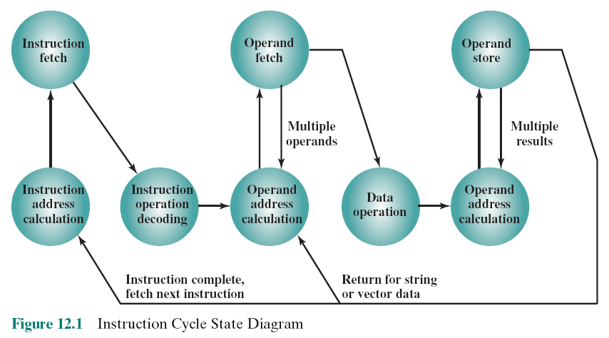
Instruction Cycle State Diagram
Notes:
3
Figure 12.1, which repeats Figure 3.6, shows the steps involved in instruction execution and, by implication, defines the elements of a machine instruction.
The address of the next instruction to be fetched could be either a real address or a virtual address, depending on the architecture. Generally, the distinction is transparent to the instruction set architecture. In most cases, the next instruction to be fetched immediately follows the current instruction. In those cases, there is no explicit reference to the next instruction. When an explicit reference is needed, then the main memory or virtual memory address must be supplied. The form in which that address is supplied is discussed in Chapter 13.

Slide 7
Source and result operands can be in one of four areas:
Processor register
A processor contains one or more registers that may be referenced by machine instructions.
If more than one register exists each register is assigned a unique name or number and the instruction must contain the number of the desired register
Opcode
Operand1
Operand2
Operand3
Main or virtual memory
As with next instruction references, the main or virtual memory address must be supplied
I/O device
The instruction must specify the I/O module and device for the operation. If memory-mapped I/O is used, this is just another main or virtual memory address
Immediate
The value of the operand is contained in a field in the instruction being executed
Notes:
4
Source and result operands can be in one of four areas:
Main or virtual memory: As with next instruction references, the main or virtual memory address must be supplied.
Processor register: With rare exceptions, a processor contains one or more registers that may be referenced by machine instructions. If only one register exists, reference to it may be implicit. If more than one register exists, then each register is assigned a unique name or number, and the instruction must contain the number of the desired register.
Immediate: The value of the operand is contained in a field in the instruction being executed.
I/O device: The instruction must specify the I/O module and device for the operation. If memory-mapped I/O is used, this is just another main or virtual memory address.

Slide 8
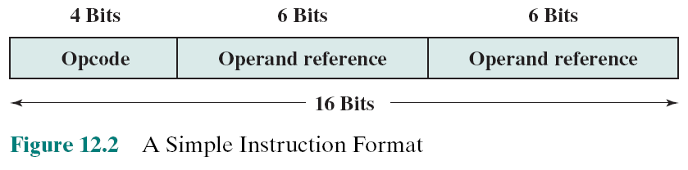

Instruction Representation
Within the computer each instruction is represented by a sequence of bits
The instruction is divided into fields, corresponding to the constituent elements of the instruction
Notes:
5
Within the computer, each instruction is represented by a sequence of bits. The instruction is divided into fields, corresponding to the constituent elements of the instruction.
A simple example of an instruction format is shown in Figure 12.2. As another example, the IAS instruction format is shown in Figure 2.2. With most instruction sets, more than one format is used. During instruction execution, an instruction is read into an instruction register (IR) in the processor. The processor must be able to extract the data from the various instruction fields to perform the required operation.
It is difficult for both the programmer and the reader of textbooks to deal with binary representations of machine instructions. Thus, it has become common practice to use a symbolic representation of machine instructions. An example of this was used for the IAS instruction set, in Table 2.1.

Slide 9
Instruction Types
Arithmetic instructions provide computational capabilities for processing numeric data
Logic (Boolean) instructions operate on the bits of a word as bits rather than as numbers, thus they provide capabilities for processing any other type of data the user may wish to employ
Movement of data into or out of register and or memory locations
Data processing
Data storage
Control
Data movement
Test instructions are used to test the value of a data word or the status of a computation
Branch instructions are used to branch to a different set of instructions depending on the decision made
I/O instructions are needed to transfer programs and data into memory and the results of computations back out to the user
Notes:
6
A computer should have a set of instructions that allows the user to formulate any data processing task. Another way to view it is to consider the capabilities of a high-level programming language. Any program written in a high-level language must be translated into machine language to be executed. Thus, the set of machine instructions must be sufficient to express any of the instructions from a high-level language. With this in mind we can categorize instruction types as follows:
Data processing: Arithmetic and logic instructions
Data storage: Movement of data into or out of register and or memory
locations
Data movement: I/O instructions
Control: Test and branch instructions
Arithmetic instructions provide computational capabilities for processing numeric data. Logic (Boolean) instructions operate on the bits of a word as bits rather than as numbers; thus, they provide capabilities for processing any other type of data the user may wish to employ. These operations are performed primarily on data in processor registers. Therefore, there must be memory instructions for moving data between memory and the registers. I/O instructions are needed to transfer programs and data into memory and the results of computations back out to the user. Test instructions are used to test the value of a data word or the status of a computation. Branch instructions are then used to branch to a different set of instructions depending on the decision made.

Slide 10
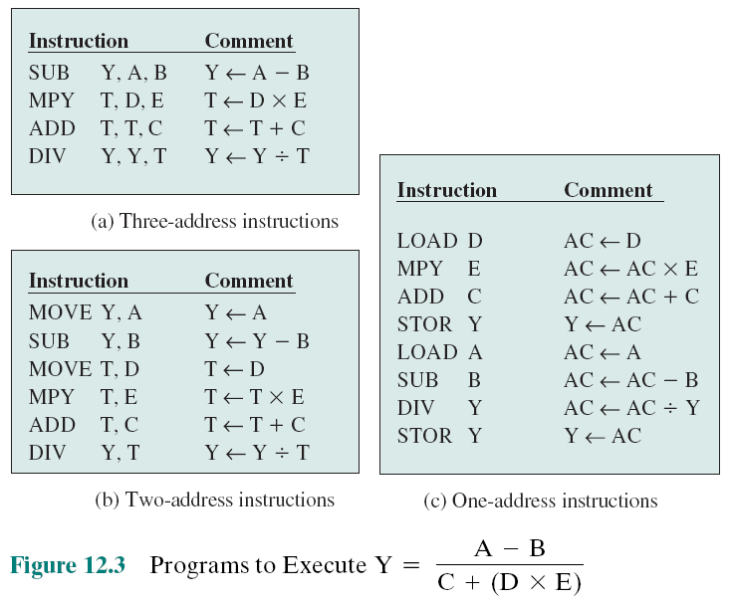

Number of Addresses
Notes:
7
Figure 12.3 compares typical one, two, and three address instructions that
could be used to compute Y = (A – B)/[C + (D * E)]. With three addresses, each instruction specifies two source operand locations and a destination operand location. Because we choose not to alter the value of any of the operand locations, a temporary location, T, is used to store some intermediate results. Note that there are four instructions and that the original expression had five operands.
Three-address instruction formats are not common because they require a relatively long instruction format to hold the three address references. With two- address instructions, and for binary operations, one address must do double duty as both an operand and a result. Thus, the instruction SUB Y, B carries out the calculation Y - B and stores the result in Y. The two-address format reduces the space requirement but also introduces some awkwardness. To avoid altering the value of an operand, a MOVE instruction is used to move one of the values to a result or temporary location before performing the operation. Our sample program expands to six instructions.
Simpler yet is the one-address instruction. For this to work, a second address must be implicit. This was common in earlier machines, with the implied address being a processor register known as the accumulator (AC). The accumulator contains one of the operands and is used to store the result. In our example, eight instructions are needed to accomplish the task.
It is, in fact, possible to make do with zero addresses for some instructions. Zero-address instructions are applicable to a special memory organization called a stack. A stack is a last-in-first-out set of locations. The stack is in a known location and, often, at least the top two elements are in processor registers. Thus, zero-address instructions would reference the top two stack elements. Stacks are described in Appendix O. Their use is explored further later in this chapter and in Chapter 13.

Slide 11
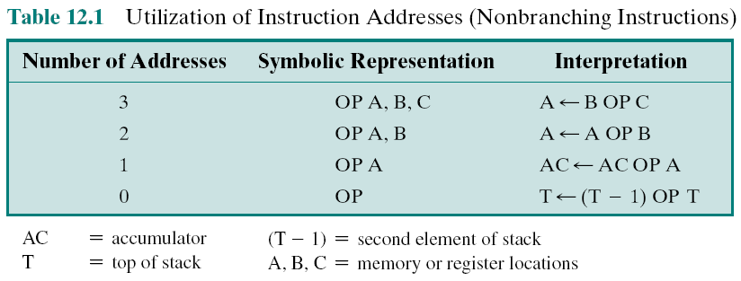
Table 12.1 Utilization of Instruction Addresses (Nonbranching Instructions)
3
5
2
1
Notes:
8
Table 12.1 summarizes the interpretations to be placed on instructions with zero, one, two, or three addresses. In each case in the table, it is assumed that the address of the next instruction is implicit, and that one operation with two source operands and one result operand is to be performed.
The number of addresses per instruction is a basic design decision. Fewer addresses per instruction result in instructions that are more primitive, requiring a less complex processor. It also results in instructions of shorter length. On the other hand, programs contain more total instructions, which in general results in longer execution times and longer, more complex programs. Also, there is an important threshold between one-address and multiple-address instructions. With one-address instructions, the programmer generally has available only one general-purpose register, the accumulator. With multiple-address instructions, it is common to have multiple general-purpose registers. This allows some operations to be performed
solely on registers. Because register references are faster than memory references, this speeds up execution. For reasons of flexibility and ability to use multiple registers, most contemporary machines employ a mixture of two- and three-address instructions.
The design trade-offs involved in choosing the number of addresses per instruction are complicated by other factors. There is the issue of whether an address references a memory location or a register. Because there are fewer registers, fewer bits are needed for a register reference. Also, as we shall see in Chapter 13, a machine may offer a variety of addressing modes, and the specification of mode takes one or more bits. The result is that most processor designs involve a variety of instruction formats.

Slide 12
Instruction Set Design
Very complex because it affects so many aspects of the computer system
Defines many of the functions performed by the processor
Programmer’s means of controlling the processor
Fundamental design issues:
Operation repertoire
How many and which operations to provide and how complex operations should be
Data types
The various types of data upon which operations are performed
Instruction format
Instruction length in bits, number of addresses, size of various fields, etc.
Registers
Number of processor registers that can be referenced by instructions and their use
Addressing
The mode or modes by which the address of an operand is specified
Repertoire: items
Notes:
9
One of the most interesting, and most analyzed, aspects of computer design is instruction set design. The design of an instruction set is very complex because it affects so many aspects of the computer system. The instruction set defines many of the functions performed by the processor and thus has a significant effect on the implementation of the processor. The instruction set is the programmer’s means of controlling the processor. Thus, programmer requirements must be considered in designing the instruction set.
It may surprise you to know that some of the most fundamental issues relating to the design of instruction sets remain in dispute. Indeed, in recent years, the level of disagreement concerning these fundamentals has actually grown. The most important of these fundamental design issues include the following:
Operation repertoire: How many and which operations to provide, and how complex operations should be
Data types: The various types of data upon which operations are performed
Instruction format: Instruction length (in bits), number of addresses, size of
various fields, and so on
Registers: Number of processor registers that can be referenced by instructions, and their use
Addressing: The mode or modes by which the address of an operand is specified
These issues are highly interrelated and must be considered together in designing an instruction set. This book, of course, must consider them in some sequence, but an attempt is made to show the interrelationships.

Slide 13
12.2- Types of Operands
Addresses
Numbers
They may be
Characters
Logical Data
Notes:
14
Machine instructions operate on data. The most important general categories of data are
Addresses, Numbers , Characters , Logical data
We shall see, in discussing addressing modes in Chapter 13, that addresses are, in fact, a form of data. In many cases, some calculation must be performed on the operand reference in an instruction to determine the main or virtual memory address. In this context, addresses can be considered to be unsigned integers.
Other common data types are numbers, characters, and logical data, and each of these is briefly examined in this section. Beyond that, some machines define specialized data types or data structures. For example, there may be machine operations that operate directly on a list or a string of characters.

Slide 14
Numbers
All machine languages include numeric data types
Numbers stored in a computer are limited:
Limit to the magnitude of numbers representable on a machine
In the case of floating-point numbers, a limit to their precision
Three types of numerical data are common in computers:
Binary integer or binary fixed point
Binary floating point
Decimal
Packed decimal (số thập phân nén)
Each decimal digit is represented by a 4-bit code with two digits stored per byte
10 digits 🡪 4 bits /digit
1 byte/2 digits
’37’ 🡺
0011 0111
Notes:
All machine languages include numeric data types. Even in nonnumeric data processing, there is a need for numbers to act as counters, field widths, and so forth. An important distinction between numbers used in ordinary mathematics and numbers stored in a computer is that the latter are limited. This is true in two senses. First, there is a limit to the magnitude of numbers representable on a machine and second, in the case of floating-point numbers, a limit to their precision. Thus, the programmer is faced with understanding the consequences of rounding, overflow, and underflow.
Three types of numerical data are common in computers:
Binary integer or binary fixed point
Binary floating point
Decimal
We examined the first two in some detail in Chapter 10. It remains to say a few words about decimal numbers.
Although all internal computer operations are binary in nature, the human users of the system deal with decimal numbers. Thus, there is a necessity to convert from decimal to binary on input and from binary to decimal on output. For applications in which there is a great deal of I/O and comparatively little, comparatively simple computation, it is preferable to store and operate on the numbers in decimal form. The most common representation for this purpose is packed decimal.
With packed decimal, each decimal digit is represented by a 4-bit code, in the obvious way, with two digits stored per byte. Thus, 0 = 000, 1 = 0001, c, 8 = 1000, and 9 = 1001. Note that this is a rather inefficient code because only 10 of 16 possible 4-bit values are used. To form numbers, 4-bit codes are strung together, usually in multiples of 8 bits. Thus, the code for 246 is 0000 0010 0100 0110. This code is clearly less compact than a straight binary representation, but it avoids the con- version overhead. Negative numbers can be represented by including a 4-bit sign digit at either the left or right end of a string of packed decimal digits. Standard sign values are 1100 for positive (+) and 1101 for negative (-).
Many machines provide arithmetic instructions for performing operations directly on packed decimal numbers. The algorithms are quite similar to those described in Section 9.3 but must take into account the decimal carry operation.

Slide 15
Characters
A common form of data is text or character strings
Textual data in character form cannot be easily stored or transmitted by data processing and communications systems because they are designed for binary data
Most commonly used character code is the International Reference Alphabet (IRA)
Referred to in the United States as the American Standard Code for Information Interchange (ASCII)
Another code used to encode characters is the Extended Binary Coded Decimal Interchange Code
EBCDIC is used on IBM mainframes
Notes:
A common form of data is text or character strings. While textual data are most convenient for human beings, they cannot, in character form, be easily stored or transmitted by data processing and communications systems. Such systems are designed for binary data. Thus, a number of codes have been devised by which characters are represented by a sequence of bits. Perhaps the earliest common example of this is the Morse code. Today, the most commonly used character code in the International Reference Alphabet (IRA), referred to in the United States as the American Standard Code for Information Interchange (ASCII; see Appendix F). Each character in this code is represented by a unique 7-bit pattern; thus, 128 different characters can be represented. This is a larger number than is necessary to represent printable characters, and some of the patterns represent control characters. Some of these control characters have to do with controlling the printing of characters on a page. Others are concerned with communications procedures. IRA-encoded characters are almost always stored and transmitted using 8 bits per character. The eighth bit may be set to 0 or used as a parity bit for error detection. In the latter case, the bit is set such that the total number of binary 1s in each octet is always odd (odd parity) or always even (even parity).
Note in Table F.1 (Appendix F) that for the IRA bit pattern 011XXXX, the digits 0 through 9 are represented by their binary equivalents, 0000 through 1001, in the rightmost 4 bits. This is the same code as packed decimal. This facilitates con- version between 7-bit IRA and 4-bit packed decimal representation.
Another code used to encode characters is the Extended Binary Coded Decimal Interchange Code (EBCDIC). EBCDIC is used on IBM mainframes. It is an 8-bit code. As with IRA, EBCDIC is compatible with packed decimal. In the case of EBCDIC, the codes 11110000 through 11111001 represent the digits 0 through 9.

Slide 16
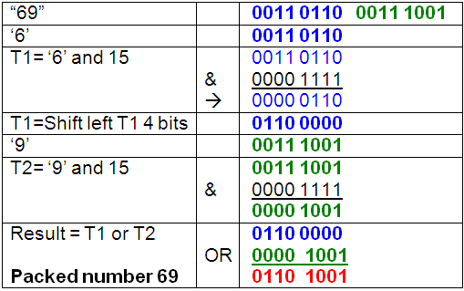
How to create a packed number:
“69”:
Packed 69:
0011 0110
0011 1001
0110 1001

Slide 17
Logical Data
An n-bit unit (byte, half word, …) consisting of n 1-bit items of data, each item having the value 0 or 1
Two advantages to bit-oriented view:
Memory can be used most efficiently for storing an array of Boolean or binary data items in which each item can take on only the values 1 (true) and 0 (false)
To manipulate the bits of a data item
If floating-point operations are implemented in software, we need to be able to shift significant bits in some operations
To convert from IRA to packed decimal, we need to extract the rightmost 4 bits of each byte
Notes:
Normally, each word or other addressable unit (byte, halfword, and so on) is treated as a single unit of data. It is sometimes useful, however, to consider an n-bit unit as consisting of n 1-bit items of data, each item having the value 0 or 1. When data are viewed this way, they are considered to be logical data.
There are two advantages to the bit-oriented view. First, we may sometimes wish to store an array of Boolean or binary data items, in which each item can take on only the values 1 (true) and 0 (false). With logical data, memory can be used most efficiently for this storage. Second, there are occasions when we wish to manipulate the bits of a data item. For example, if floating-point operations are implemented in software, we need to be able to shift significant bits in some operations. Another example: To convert from IRA to packed decimal, we need to extract the rightmost 4 bits of each byte.
Note that, in the preceding examples, the same data are treated sometimes as logical and other times as numerical or text. The “type” of a unit of data is deter- mined by the operation being performed on it. While this is not normally the case in high-level languages, it is almost always the case with machine language.

Slide 18
12.4- Types of Operations
Useful and typical categorization:
Data transfer
Arithmetic
Logical
Conversion
I/O
System control
Transfer of control

Slide 19
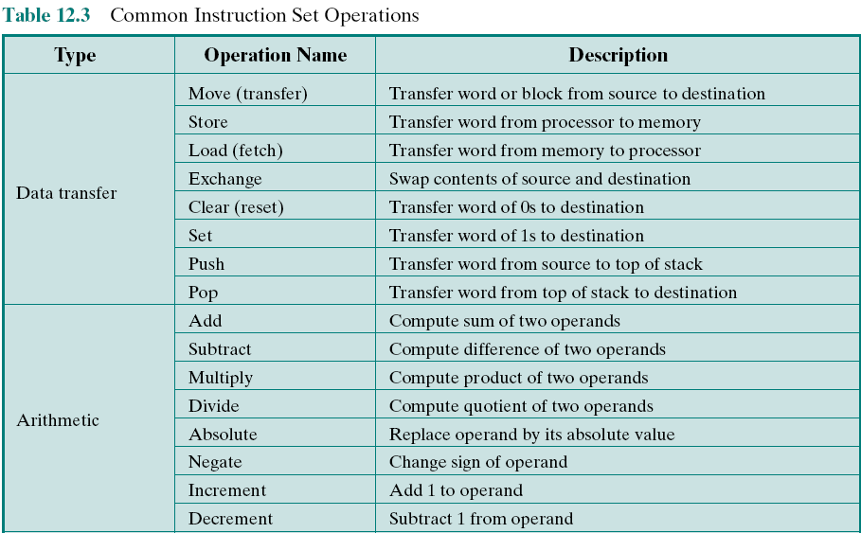
Table 12.3 Common Instruction Set Operations(page 1 of 3)
Notes:
18
The number of different opcodes varies widely from machine to machine. However, the same general types of operations are found on all machines. A useful and typical categorization is the following:
Data transfer
Arithmetic
Logical
Conversion
I/O
System control
Transfer of control
Table 12.3 (based on [HAYE98]) lists common instruction types in each category.

Slide 20
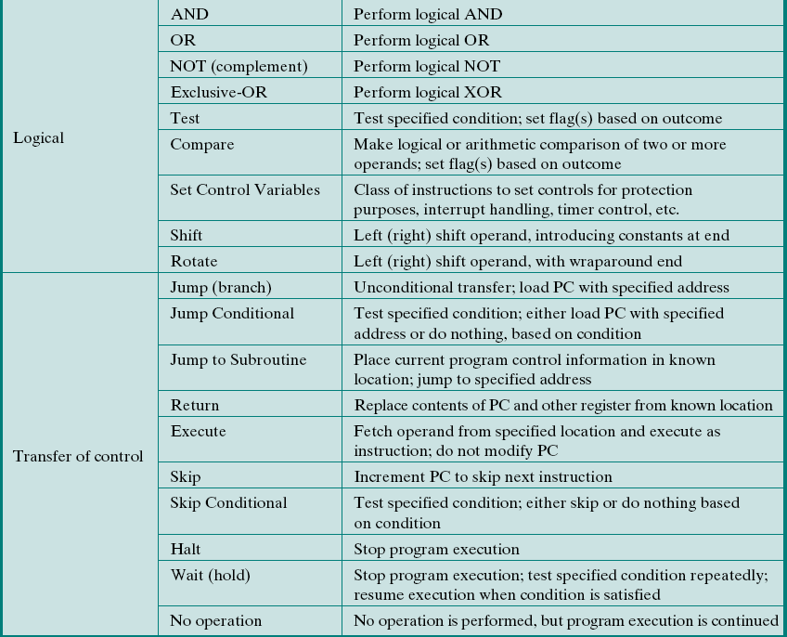
Table 12.3 Common Instruction Set Operations (page 2 of 3)
Notes:
18

Slide 21
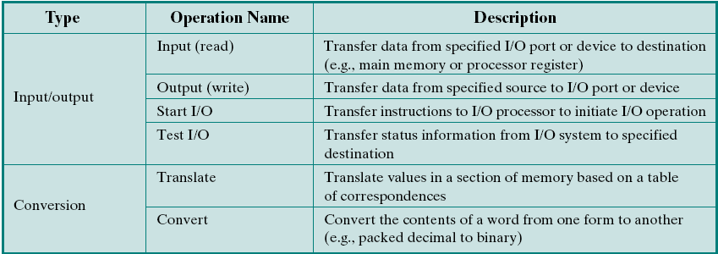
Table 12.3 Common Instruction Set Operations (page 3 of 3)
Notes:
18

Slide 22
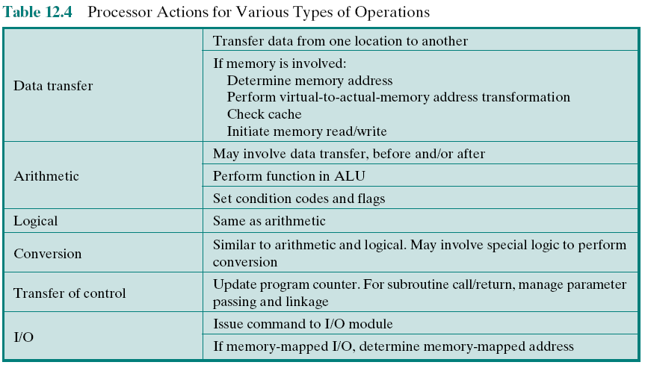
Table 12.4 Processor Actions for Various Types of Operations
Notes:
This section provides a brief survey of these various types of operations, together with a brief discussion of the actions taken by the processor to execute a particular type of operation (summarized in Table 12.4).

Slide 23


Data Transfer
Most fundamental type of machine instruction
Must specify:
Location of the source and destination operands
The length of data to be transferred must be indicated
The mode of addressing for each operand must be specified
Notes:
19
The most fundamental type of machine instruction is the data transfer instruction. The data transfer instruction must specify several things. First, the location of the source and destination operands must be specified. Each location could be memory, a register, or the top of the stack. Second, the length of data to be transferred must be indicated. Third, as with all instructions with operands, the mode of addressing for each operand must be specified. This latter point is discussed in Chapter 13.

Slide 24
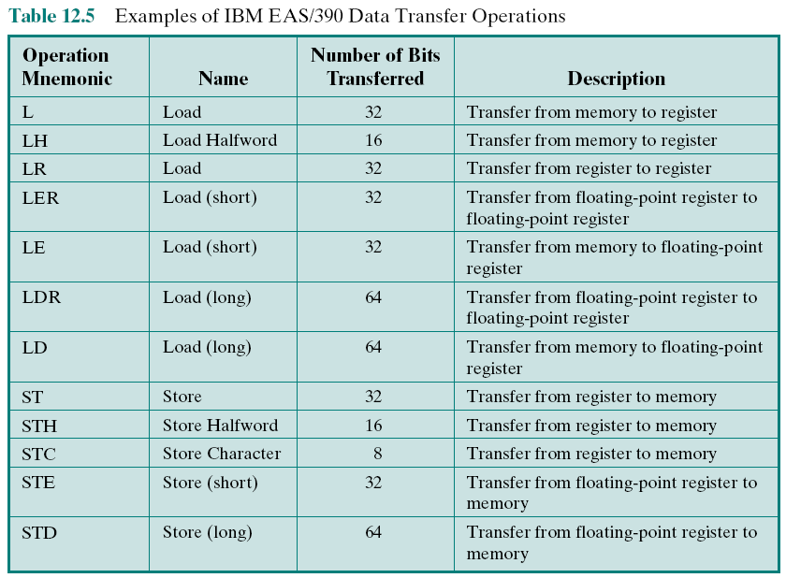
Table 12.5 : Examples of IBM EAS/390 Data Transfer Operations
Notes:
The choice of data transfer instructions to include in an instruction set exemplifies the kinds of trade-offs the designer must make. For example, the general location (memory or register) of an operand can be indicated in either the specification of the opcode or the operand. Table 12.5 shows examples of the most common IBM EAS/390 data transfer instructions. Note that there are variants to indicate
the amount of data to be transferred (8, 16, 32, or 64 bits). Also, there are different instructions for register to register, register to memory, memory to register, and memory to memory transfers. In contrast, the VAX has a move (MOV) instruction with variants for different amounts of data to be moved, but it specifies whether an operand is register or memory as part of the operand. The VAX approach is some- what easier for the programmer, who has fewer mnemonics to deal with. However, it is also somewhat less compact than the IBM EAS/390 approach because the location (register versus memory) of each operand must be specified separately in the instruction.

Slide 25

Arithmetic
Most machines provide the basic arithmetic operations of add, subtract, multiply, and divide
These are provided for signed integer (fixed-point) numbers
Often they are also provided for floating-point and packed decimal numbers
Other possible operations include a variety of single-operand instructions:
Absolute
Take the absolute value of the operand
Negate
Negate the operand
Increment
Add 1 to the operand
Decrement
Subtract 1 from the operand
Notes:
20
Most machines provide the basic arithmetic operations of add, subtract, multi- ply, and divide. These are invariably provided for signed integer (fixed-point) numbers. Often they are also provided for floating-point and packed decimal numbers.
Other possible operations include a variety of single-operand instructions; for example,
• Absolute: Take the absolute value of the operand.
• Negate: Negate the operand.
• Increment: Add 1 to the operand.
• Decrement: Subtract 1 from the operand.
The execution of an arithmetic instruction may involve data transfer operations to position operands for input to the ALU, and to deliver the output of the ALU. Figure 3.5 illustrates the movements involved in both data transfer and arithmetic operations. In addition, of course, the ALU portion of the processor performs the desired operation.

Slide 26
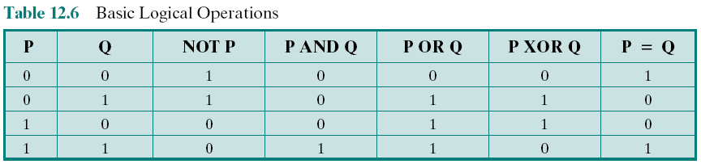
Logical
(R1) = 1010 0101
(R2) = 1111 1111
then (R1) XOR (R2) = 0101 1010
Notes:
21
Most machines also provide a variety of operations for manipulating individual bits of a word or other addressable units, often referred to as “bit twiddling.” They are based upon Boolean operations (see Chapter 11).
Some of the basic logical operations that can be performed on Boolean or binary data are shown in Table 12.6. The NOT operation inverts a bit. AND, OR, and Exclusive-OR (XOR) are the most common logical functions with two operands. EQUAL is a useful binary test.

Slide 27
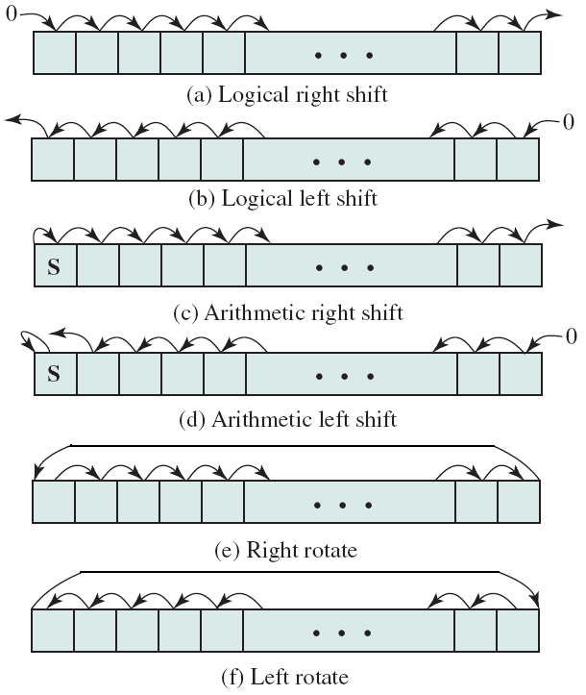
Shift and Rotate Operations Figure 12.6- Shift and Rotate Operations
Notes:
In addition to bitwise logical operations, most machines provide a variety of shifting and rotating functions. The most basic operations are illustrated in Figure 12.6. With a logical shift, the bits of a word are shifted left or right. On one end, the bit shifted out is lost. On the other end, a 0 is shifted in. Logical shifts are useful primarily for isolating fields within a word. The 0s that are shifted into a word displace unwanted information that is shifted off the other end.

Slide 28
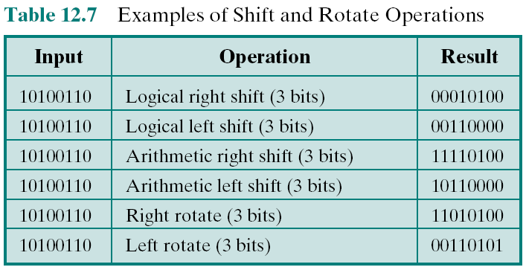
Table 12.7 Examples of Shift and Rotate Operations
Notes:
The arithmetic shift operation treats the data as a signed integer and does
not shift the sign bit. On a right arithmetic shift, the sign bit is replicated into the bit position to its right. On a left arithmetic shift, a logical left shift is performed on all bits but the sign bit, which is retained. These operations can speed up certain arithmetic operations. With numbers in twos complement notation, a right arithmetic shift corresponds to a division by 2, with truncation for odd numbers. Both an arithmetic left shift and a logical left shift correspond to a multiplication by 2 when there is no overflow. If overflow occurs, arithmetic and logical left shift operations produce different results, but the arithmetic left shift retains the sign of the number. Because of the potential for overflow, many processors do not include this instruction, including PowerPC and Itanium. Others, such as the IBM EAS/390, do offer the instruction. Curiously, the x86 architecture includes an arithmetic left shift but defines it to be identical to a logical left shift.
Rotate, or cyclic shift, operations preserve all of the bits being operated on. One use of a rotate is to bring each bit successively into the leftmost bit, where it can be identified by testing the sign of the data (treated as a number).
As with arithmetic operations, logical operations involve ALU activity and may involve data transfer operations. Table 12.7 gives examples of all of the shift and rotate operations discussed in this subsection.

Slide 29
Conversion
Instructions that change the format or operate on the format of data
An example of a more complex editing instruction is the EAS/390 Translate (TR) instruction
An example is converting from decimal to binary
Notes:
22
Conversion instructions are those that change the format or operate on the format of data. An example is converting from decimal to binary. An example of a more complex editing instruction is the EAS/390 Translate (TR) instruction. This instruction can be used to convert from one 8-bit code to another, and it takes three operands:
TR R1 (L), R2
The operand R2 contains the address of the start of a table of 8-bit codes. The L bytes starting at the address specified in R1 are translated, each byte being replaced by the contents of a table entry indexed by that byte. For example, to translate from EBCDIC to IRA, we first create a 256-byte table in storage locations, say, 1000-10FF hexadecimal. The table contains the characters of the IRA code in the sequence of the binary representation of the EBCDIC code; that is, the IRA code is placed in the table at the relative location equal to the binary value of the EBCDIC code of the same character. Thus, locations 10F0 through 10F9 will contain the values 30 through 39, because F0 is the EBCDIC code for the digit 0, and 30 is the IRA code for the digit 0, and so on through digit 9. Now suppose we have the EBCDIC for the digits 1984 starting at location 2100 and we wish to trans- late to IRA. Assume the following:
• Locations 2100–2103 contain F1 F9 F8 F4.
• R1 contains 2100.
• R2 contains 1000.
Then, if we execute
TR R1 (4), R2
locations 2100–2103 will contain 31 39 38 34.

Slide 30

Input/Output
Variety of approaches taken:
Isolated programmed I/O
Memory-mapped programmed I/O
DMA
Use of an I/O processor
Many implementations provide only a few I/O instructions, with the specific actions specified by parameters, codes, or command words
Notes:
23
Input/output instructions were discussed in some detail in Chapter 7. As we saw, there are a variety of approaches taken, including isolated programmed I/O, memory-mapped programmed I/O, DMA, and the use of an I/O processor. Many implementations provide only a few I/O instructions, with the specific actions specified by parameters, codes, or command words.

Slide 31
System Control
Instructions that can be executed only while the processor is in a certain privileged state or is executing a program in a special privileged area of memory
Typically these instructions are reserved for the use of the operating system
Examples of system control operations:
A system control instruction may read or alter a control register
An instruction to read or modify a storage protection key
Access to process control blocks in a multiprogramming system
Notes:
24
System control instructions are those that can be executed only while the processor is in a certain privileged state or is executing a program in a special privileged area of memory. Typically, these instructions are reserved for the use of the operating system.
Some examples of system control operations are as follows. A system control instruction may read or alter a control register; we discuss control registers in Chapter 14. Another example is an instruction to read or modify a storage protection key, such as is used in the EAS/390 memory system. Another example is access to process control blocks in a multiprogramming system.

Slide 32
Transfer of Control
Reasons why transfer-of-control operations are required:
It is essential to be able to execute each instruction more than once
Virtually all programs involve some decision making
It helps if there are mechanisms for breaking the task up into smaller pieces that can be worked on one at a time
Most common transfer-of-control operations found in instruction sets:
Branch
Skip
Procedure call
Notes:
25
For all of the operation types discussed so far, the next instruction to be performed is the one that immediately follows, in memory, the current instruction. However, a significant fraction of the instructions in any program have as their function changing the sequence of instruction execution. For these instructions, the operation per- formed by the processor is to update the program counter to contain the address of some instruction in memory.
There are a number of reasons why transfer-of-control operations are required. Among the most important are the following:
In the practical use of computers, it is essential to be able to execute each instruction more than once and perhaps many thousands of times. It may require thousands or perhaps millions of instructions to implement an application. This would be unthinkable if each instruction had to be written out separately. If a table or a list of items is to be processed, a program loop is needed. One sequence of instructions is executed repeatedly to process all the data.
Virtually all programs involve some decision making. We would like the computer to do one thing if one condition holds, and another thing if another condition holds. For example, a sequence of instructions computes the square root of a number. At the start of the sequence, the sign of the number is tested. If the number is negative, the computation is not performed, but an error condition is reported.
To compose correctly a large or even medium-size computer program is an exceedingly difficult task. It helps if there are mechanisms for breaking the task up into smaller pieces that can be worked on one at a time.

Slide 33
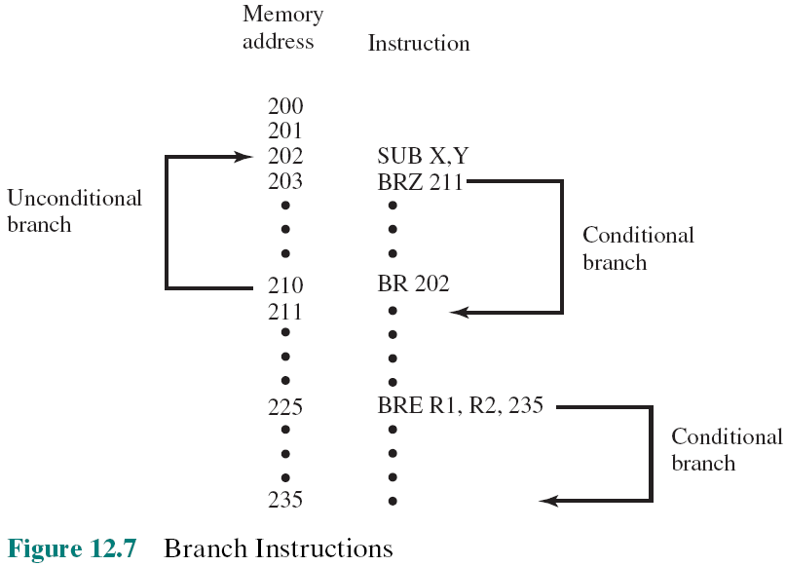
Branch Instruction
BRP X : Branch to location X if result is positive.
BRN X : Branch to location X if result is negative.
BRZ X : Branch to location X if result is zero.
BRO X : Branch to location X if overflow occurs.
BRE R1, R2, X : Branch to X if value of R1 = value of R2.
Notes:
A branch instruction, also called a jump instruction, has as one of its operands the address of the next instruction to be executed. Most often, the instruction is a conditional branch instruction. That is, the branch is made (update program counter to equal address specified in operand) only if a certain condition is met. Otherwise, the next instruction in sequence is executed (increment program counter as usual). A branch instruction in which the branch is always taken is an unconditional branch.
Figure 12.7 shows examples of these operations. Note that a branch can be either forward (an instruction with a higher address) or backward (lower address). The example shows how an unconditional and a conditional branch can be used to create a repeating loop of instructions. The instructions in locations 202 through 210 will be executed repeatedly until the result of subtracting Y from X is 0.

Slide 34
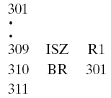
Skip Instructions
Includes an implied address
Typically implies that one instruction be skipped, thus the implied address equals the address of the next instruction plus one instruction length
Because the skip instruction does not require a destination address field it is free to do other things
Example is the increment-and-skip-if-zero (ISZ) instruction
Notes:
Another form of transfer-of-control instruction is the skip instruction. The skip instruction includes an implied address. Typically, the skip implies that one instruction be skipped; thus, the implied address equals the address of the next instruction plus one instruction length.
Because the skip instruction does not require a destination address field, it is free to do other things. A typical example is the increment-and-skip-if-zero (ISZ) instruction.

Slide 35
Procedure Call Instructions
Self-contained codes that is incorporated into a larger program
At any point in the program the procedure may be invoked, or called
Processor is instructed to go and execute the entire procedure and then return to the point from which the call took place
Two principal reasons for use of procedures:
Economy: The same piece of code to be used many times
Modularity
Involves two basic instructions:
A call instruction that branches from the present location to the procedure
Return instruction that returns from the procedure to the place from which it was called
Notes:
Perhaps the most important innovation in the development of programming languages is the procedure. A procedure is a self- contained computer program that is incorporated into a larger program. At any point in the program the procedure may be invoked, or called. The processor is instructed to go and execute the entire procedure and then return to the point from which the call took place.
The two principal reasons for the use of procedures are economy and modularity. A procedure allows the same piece of code to be used many times. This is important for economy in programming effort and for making the most efficient use of storage space in the system (the program must be stored). Procedures also allow large programming tasks to be subdivided into smaller units. This use of modularity greatly eases the programming task.
The procedure mechanism involves two basic instructions: a call instruction that branches from the present location to the procedure, and a return instruction that returns from the procedure to the place from which it was called. Both of these are forms of branching instructions.

Slide 36
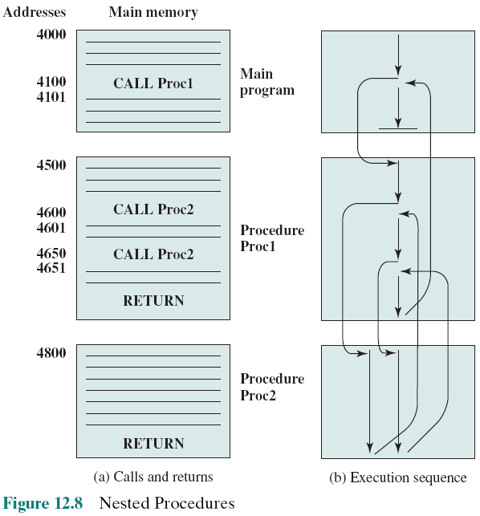
Nested Procedures
Notes:
Figure 12.8a illustrates the use of procedures to construct a program. In this example, there is a main program starting at location 4000. This program includes a call to procedure PROC1, starting at location 4500. When this call instruction is encountered, the processor suspends execution of the main program and begins execution of PROC1 by fetching the next instruction from location 4500. Within PROC1, there are two calls to PROC2 at location 4800. In each case, the execution of PROC1 is suspended and PROC2 is executed. The RETURN statement causes the processor to go back to the calling program and continue execution at the instruction after the corresponding CALL instruction. This behavior is illustrated in Figure 12.8b.

Slide 37
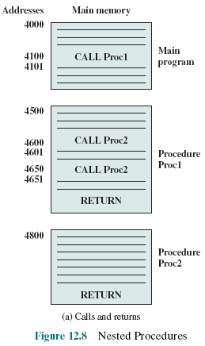
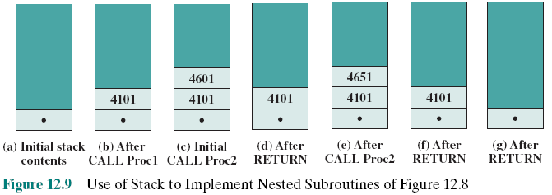
Use of Stack to Implement Nested Procedures
Notes:
A more general and powerful approach is to use a stack (see Appendix O for a discussion of stacks). When the processor executes a call, it places the return address on the stack. When it executes a return, it uses the address on the stack.
Figure 12.9 illustrates the use of the stack.

Slide 38
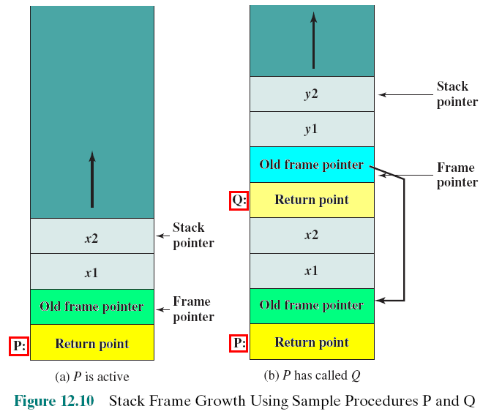
Stack Frame Growth Using Sample Procedures P and Q
Stack frame:
Data can be stacked just before a procedure is called: (1) return address, (2) parameters (3) Caller stack frame
Procedure P has local variables x1, x2, procedure Q has 2 local variables y1, y2.
Notes:
A more flexible approach to parameter passing is the stack. When the processor executes a call, it not only stacks the return address, it stacks parameters to be passed to the called procedure. The called procedure can access the parameters from the stack. Upon return, return parameters can also be placed on the stack. The entire set of parameters, including return address, that is stored for a procedure invocation is referred to as a stack frame.
An example is provided in Figure 12.10. The example refers to procedure P in which the local variables x1 and x2 are declared, and procedure Q, which P can call and in which the local variables y1 and y2 are declared. In this figure, the return point for each procedure is the first item stored in the corresponding stack frame. Next is stored a pointer to the beginning of the previous frame. This is needed if the number or length of parameters to be stacked is variable.

Slide 39
Exercises
12.1 What are the typical elements of a machine instruction?
12.2 What types of locations can hold source and destination operands?
12.3 If an instruction contains four addresses, what might be the purpose of each address?
12.4 List and briefly explain five important instruction set design issues.
12.5 What types of operands are typical in machine instruction sets?
12.6 What is the relationship between the IRA character code and the packed decimal representation?
12.7 What is the difference between an arithmetic shift and a logical shift?
12.8 Why are transfer of control instructions needed?
12.9 List and briefly explain two common ways of generating the condition to be tested in a conditional branch instruction.
12.10 What is meant by the term nesting of procedures?
12.11 List three possible places for storing the return address for a procedure return.
Notes:
2

Slide 40
Summary
Instruction Sets:
Characteristics and Functions
Chapter 12
Intel x86 and ARM data types
Types of operations
Data transfer
Arithmetic
Logical
Conversion
Input/output
System control
Transfer of control
Machine instruction characteristics
Elements of a machine instruction
Instruction representation
Instruction types
Number of addresses
Instruction set design
Types of operands
Numbers
Characters
Logical data
Notes:
Chapter 12 summary.

